Slide 1
Customer Analytics
Git and GitHub
March 19, 2019

Slide 2
Agenda
Today’s objectives
Intro to Git and GitHub
Wiki Q&A
GitHub Tutorial

Slide 3
Today’s objectives
To show you how you can use Git/GitHub in your life as an R-using data analyst.
To show you how you can submit your homework assignments for this class using Git/GitHub.
Notes:
w/Master - KK

Slide 4
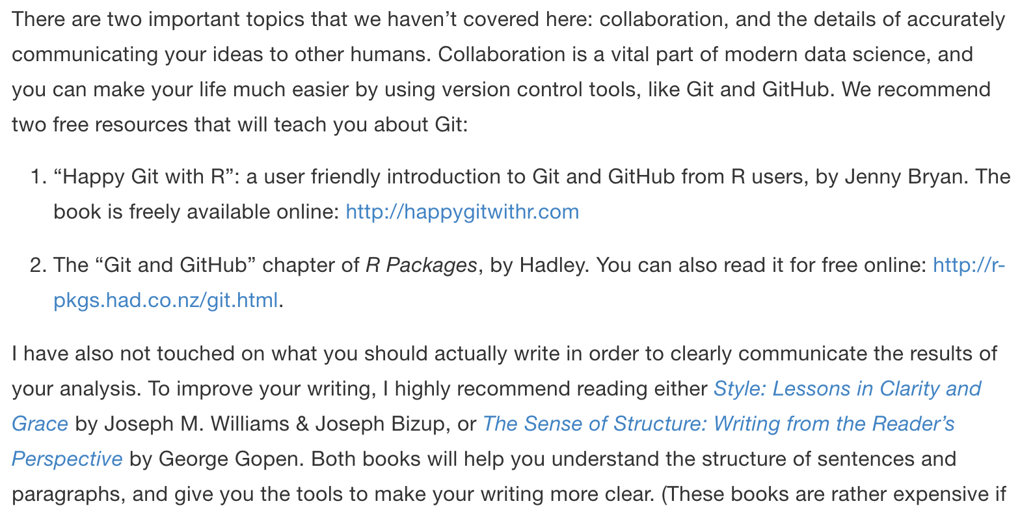
Collaboration is a vital part of modern data science
https://r4ds.had.co.nz/r-markdown.html#learning-more-3

Slide 5
It's like making your own checkpoints/saves in a video game.
How would you explain the purpose of GitHub to a 12 year old?

Slide 6
Think of Git as a more sophisticated and specialized "Track Changes" tool that Microsoft Word has
How would you explain the purpose of GitHub to a 12 year old?

Slide 7
https://commons.wikimedia.org/wiki/File:Human_evolution_scheme.svg
“commit”
a file or project state that is meaningful to you for inspection, comparison, restoration, etc.
Source: This slide is a derivative of “What They Forgot to Teach You About R,” by Jenny Bryan, used under a Creative Commons Attribution-ShareAlike 4.0 International License: http://creativecommons.org/licenses/by-sa/4.0/.

Slide 8
https://commons.wikimedia.org/wiki/File:Human_evolution_scheme.svg
△ “diff”
What changed here?
Why?
Source: This slide is a derivative of “What They Forgot to Teach You About R,” by Jenny Bryan, used under a Creative Commons Attribution-ShareAlike 4.0 International License: http://creativecommons.org/licenses/by-sa/4.0/.

Slide 9
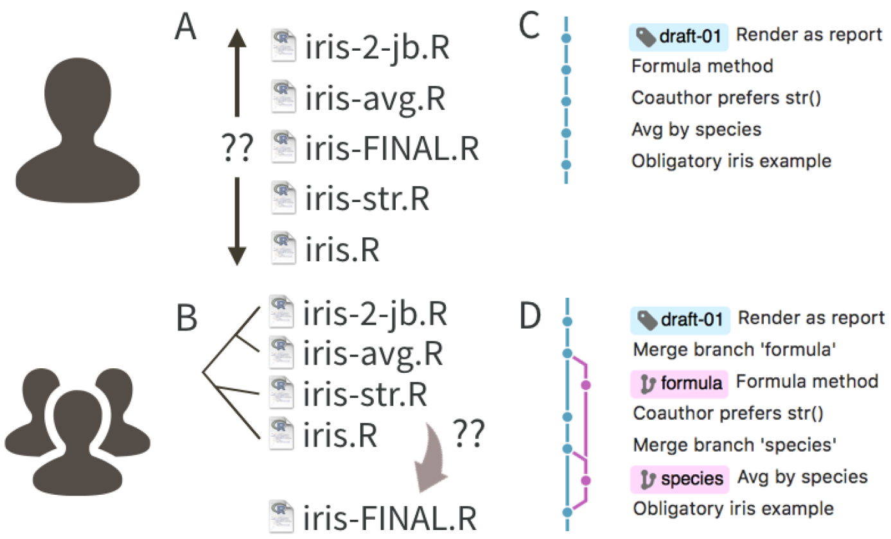
Source: This slide is a derivative of “What They Forgot to Teach You About R,” by Jenny Bryan, used under a Creative Commons Attribution-ShareAlike 4.0 International License: http://creativecommons.org/licenses/by-sa/4.0/.

Slide 10
Source: This slide is a derivative of “What They Forgot to Teach You About R,” by Jenny Bryan, used under a Creative Commons Attribution-ShareAlike 4.0 International License: http://creativecommons.org/licenses/by-sa/4.0/.

Slide 11
Source: This slide is a derivative of “What They Forgot to Teach You About R,” by Jenny Bryan, used under a Creative Commons Attribution-ShareAlike 4.0 International License: http://creativecommons.org/licenses/by-sa/4.0/.

Slide 12
Source: This slide is a derivative of “What They Forgot to Teach You About R,” by Jenny Bryan, used under a Creative Commons Attribution-ShareAlike 4.0 International License: http://creativecommons.org/licenses/by-sa/4.0/.

Slide 13
Source: This slide is a derivative of “What They Forgot to Teach You About R,” by Jenny Bryan, used under a Creative Commons Attribution-ShareAlike 4.0 International License: http://creativecommons.org/licenses/by-sa/4.0/.

Slide 14
how
feels
https://arstechnica.com/information-technology/2013/07/linus-torvalds-defends-his-right-to-shame-linux-kernel-developers/
Source: This slide is a derivative of “What They Forgot to Teach You About R,” by Jenny Bryan, used under a Creative Commons Attribution-ShareAlike 4.0 International License: http://creativecommons.org/licenses/by-sa/4.0/.

Slide 15
agony : flow

Slide 16
There is no magic pill, you need to use it frequently. Lean in, it's like learning a new language, the best strategy is immersion. It's hard at first, but using RStudio will make it better.
How can I become more comfortable in R and GitHub?

Slide 17
Frequency reduces difficulty
How can I become more comfortable in R and GitHub?
https://martinfowler.com/bliki/FrequencyReducesDifficulty.html

Slide 18
First, "Star" them if they help or inspire you. Second, if you notice a bug, make a reproducible example of the bug and open an "Issue." Third, if you know how to fix a bug/"Issue", "Fork" and make a "Pull Request." Do things in order, do not skip ahead and you will learn what all the quoted terms mean.
What is the protocol for interacting with people on GitHub you don’t know? Say you like their R scripts, etc., and want to use them?

Slide 19
git reset --hard HEAD # reset all files to the last commit
What are some useful git commands to know?

Slide 20
git status git add %>% git commit %>% git push # you can't pipe IRL, but you get the idea git pull
What are the most common tasks we will use GitHub for in our jobs?

Slide 21
Very, I would want my team to be proficient with basic git commands and understand the git flow model.
How important is the application of GitHub in the working settings for business analysts?

Slide 22
GitHub Tutorial

Slide 23
Installing the juicelaundry package
devtools::install_github(
“GCOM7140/juicelaundry”
token = “”
)
https://nyti.ms/2C558Py

